Slide 1
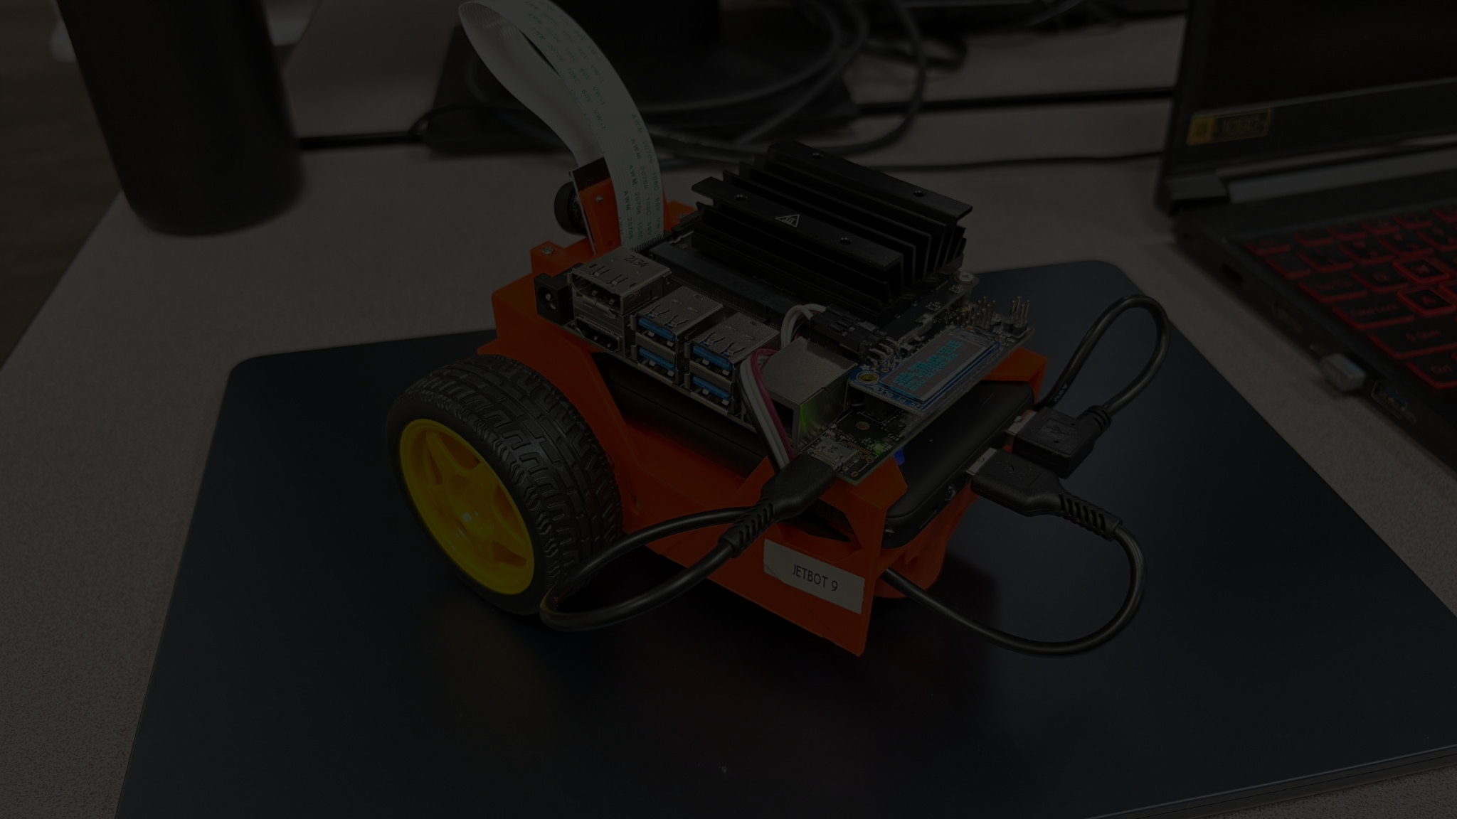
Autonomous Road Navigation with Nvidia JetBot
By Jason Nguyen, Tapendra Pandey, Bharat Kandrigi, Nanvitha Challa, Rithwik Reddy

Slide 2
Overview
This project demonstrates how to implement autonomous path following on JetBot (a small- scale robotic system powered by NVIDIA Jetson Nano)

Slide 3
Problem Statement
Traditional path following relies on explicit line detection or multiple sensors, making the system complex and less adaptable.

Slide 4
Problem Statement
Traditional path following relies on explicit line detection or multiple sensors, making the system complex and less adaptable.
Our approach replaces this with end-to-end learning, where a neural network maps camera input directly to steering commands, simplifying the pipeline and enabling easy retraining for different path types.

Slide 5
Methodology
Platform Configuration (JetBot + Controller Interface)

Slide 6
Methodology
Platform Configuration (JetBot + Controller Interface)
Data Acquisition
(Camera Based Image Capturing)

Slide 7
Methodology
Platform Configuration (JetBot + Controller Interface)
Data Acquisition
(Camera Based Image Capturing)
Model Training
(ResNet, MobileNet, ShuffleNet)

Slide 8
Methodology
Platform Configuration (JetBot + Controller Interface)
Data Acquisition
(Camera Based Image Capturing)
Model Training
(ResNet, MobileNet, ShuffleNet)
Model Implementation
(On Jetbot)

Slide 9
Models
Research involved finding what different models to use. We came across several, and used the following:
Resnet18
Shufflenet
Mobilenet

Slide 10
Models (MobileNet)
Model Configuration:
The model used is torchvision.models.mobilenet_v2(pretrained=True).
MobileNetV2 is a lightweight architecture designed for efficient inference on mobile and edge devices like Jetson Nano.
The original classifier (used for ImageNet's 1000 classes) is replaced with: model.classifier[1] = nn.Linear(model.last_channel, 2)
This modification adapts the network to predict 2 continuous outputs (X and Y steering coordinates).

Slide 11
Models (MobileNet)
Dataset and Preprocessing:
A custom dataset class XYDataset is defined. It:
Loads .jpg images and parses X and Y labels from filenames.
Applies data augmentation: color jittering and random horizontal flips.
Resizes all images to 224×224, then normalizes using ImageNet’s mean and std.
Flipped images have X-coordinate negated to maintain semantic correctness.

Slide 12
Models (MobileNet)
Training Loop Details:
For each epoch:
The model is set to train() mode.
All batches are passed through the model.
MSE loss is computed and back propagated.
After training, it enters eval() mode to compute validation loss.
Best model (lowest validation loss) is saved to disk.

Slide 13
Models (MobileNet)
Why MobileNetV2?
We selected this model for deployment due to its efficient performance, low inference latency, and consistent steering accuracy across trials.
Despite having fewer parameters (~3.4M), it performs well in our road-following task.

Slide 14
Models (ResNet18)
Network Depth & Design:
ResNet18 has 18 layers with residual blocks and skip connections.
Known for its stability and high capacity to learn visual features.

Slide 15
Models (ResNet18)
Training Setup:
Epochs: 70 — significantly longer than MobileNet/ShuffleNet
Batch size: 8
Optimizer: Adam
Loss: MSE
Same dataset and preprocessing pipeline as MobileNet

Slide 16
Models (ResNet18)
Why ResNet18?
Provides strong feature extraction, particularly helpful in complex scenarios.
However, training time and inference are heavier on Jetson Nano.
The model contains ~11.7 million parameters, making it computationally expensive.

Slide 17
Models (ResNet18)
Deployment Tradeoffs:
While training accuracy might be high, real-time performance is compromised.
Best used for experimentation, not for edge-device deployment.

Slide 18
Models (ShuffleNet)
Network Design:
ShuffleNet uses channel shuffling and pointwise group convolutions for reducing computation.
Parameters: ~2.3 million — lighter than both MobileNet and ResNet.

Slide 19
Models (ShuffleNet)
Training Setup:
Epochs: 18
Batch Size: 8
Loss Function: MSE
Optimizer: Adam

Slide 20
Models (ShuffleNet)
Why ShuffleNet?
Performs faster than ResNet18 and is comparable to MobileNet.
However, the results in your testing phase showed slightly lower stability than MobileNet.
Great alternative when model size and inference speed are top priority, but needs careful tuning.

Slide 21
Comparison
Model | Parameters | Epochs | Inference Speed | Accuracy | Jetson Suitability
ResNet18 | ~11.7M | 70 | Slow | High | (Too heavy)
ShuffleNet | ~2.3M | 18 | Fast | Moderate | Good
MobileNetV2 | ~3.4M | 13 | Fastest | Stable | Best choice

Slide 22

Training
Epochs
Certain models require a specific number of epochs to avoid issues such as overfitting during training.
We found that smaller models needed less training epochs, as shown in the diagram
70
18
13
MobilenetV2
Shufflenet
Resnet18

Slide 23
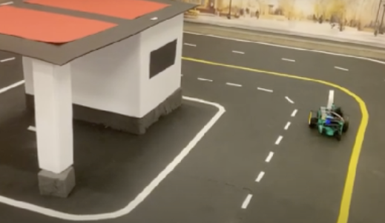
Testing Methodology
Evaluation Steps:
We had the JetBot complete the route three times in succession.
If the JetBot deviated from the route at any point, it was considered a failure and the test was restarted.
A shorter total time to complete the three loops indicated better performance.

Slide 24
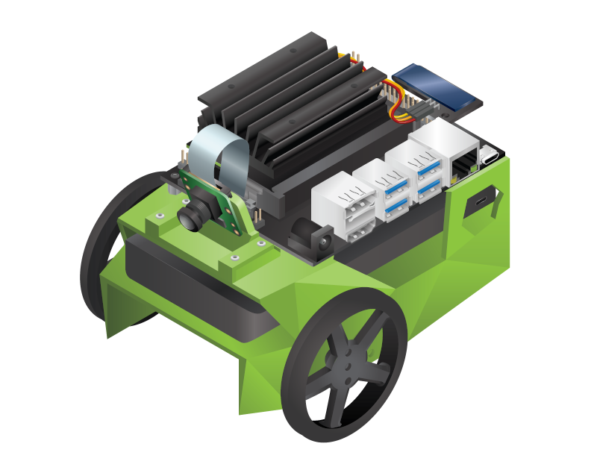
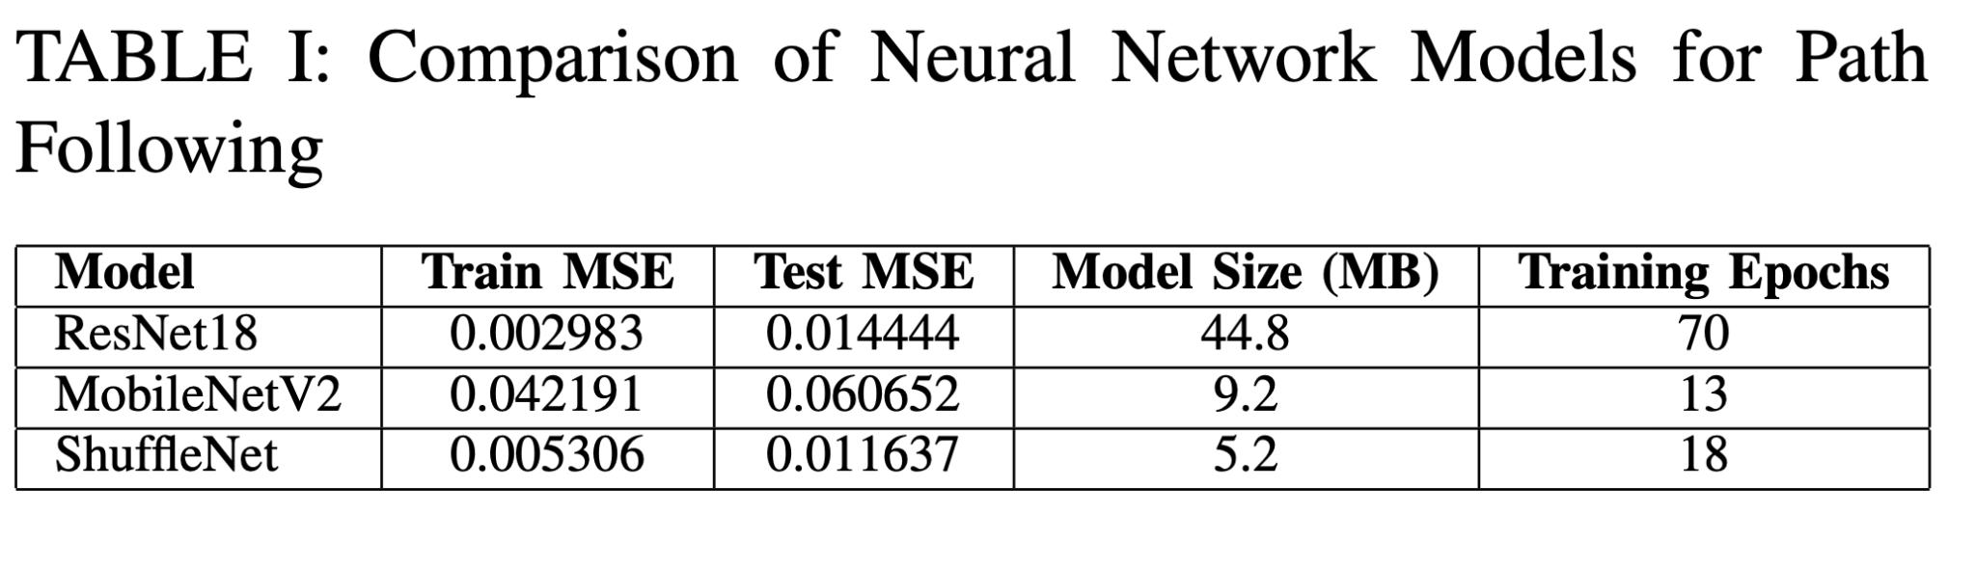
Findings
Overall, we found that ResNet18 was the most robust. The highest speed gain at which the JetBot successfully completed three loops was 0.55. MobileNetV2 ranked second, with a maximum speed gain of 0.50, while ShuffleNet came last, with a top speed gain of 0.32.
A comparison of the 3 models is shown below:

Slide 25
Conclusion
Resnet performed the best overall, while mobilenet came in second and shufflenet came in third.

Slide 26
Future Works
Model Optimization
Custom Training
Multi-model Integration
Real-time Navigation
Cloud Offloading

Slide 27
References
L. Li, H. P. H. Shum, and T. P. Breckon, “Less is more: Reducing task and model complexity for 3d point cloud semantic segmentation,” 2023. [Online]. Available: https://arxiv.org/abs/2303.11203
NVIDIA, “NVIDIA TensorRT,” https://developer.nvidia.com/tensorrt, 2025, accessed: 2025-04-30. [Online]. Available: https://developer.nvidia. com/tensorrt

Slide 28
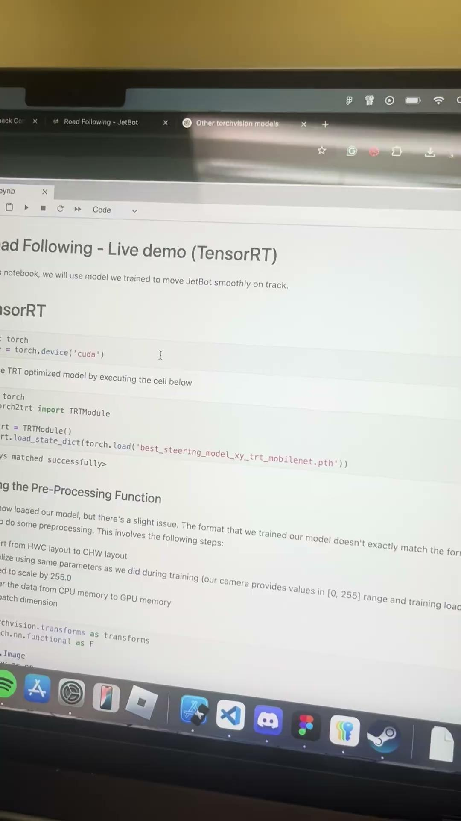
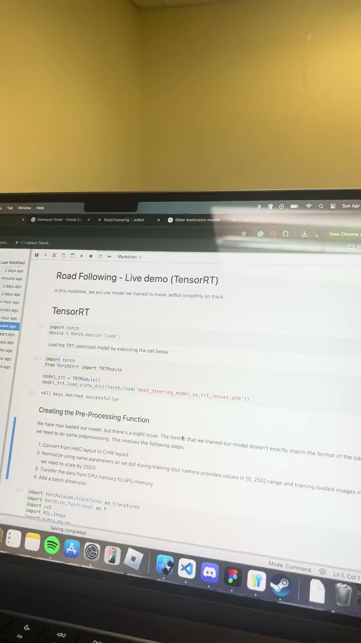
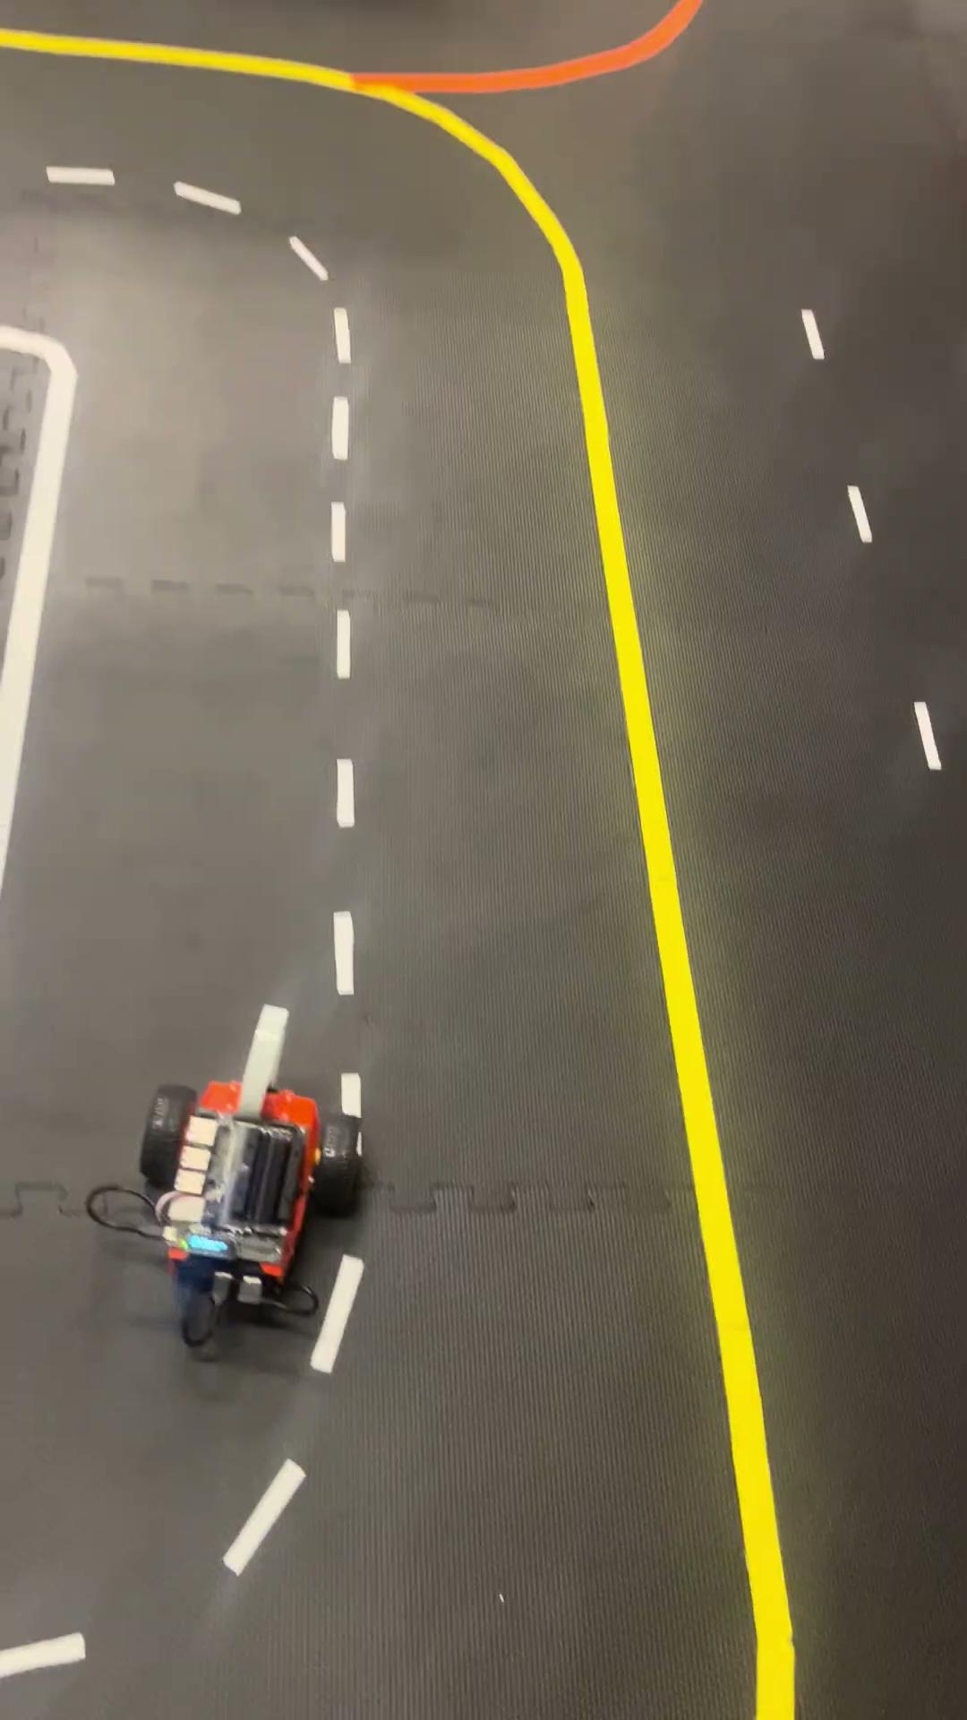
Demo
MobileNet- 30 sec
ResNet - 23sec
ShuffleNet - 40sec

